Slide 1
Chapter 06
Finding Knowledge

Slide 2
Objectives
Knowledge Application at the Individual Level
Knowledge Application at the Group and Organizational Levels
Real World Applications of KM
Strategic Implications of Knowledge Application
Practical Implications of Knowledge Application

Slide 3
Introduction
This chapter brings us to the final step in the knowledge management cycle when the knowledge that has been captured, coded, shared, and otherwise made available is put to actual use.

Slide 4
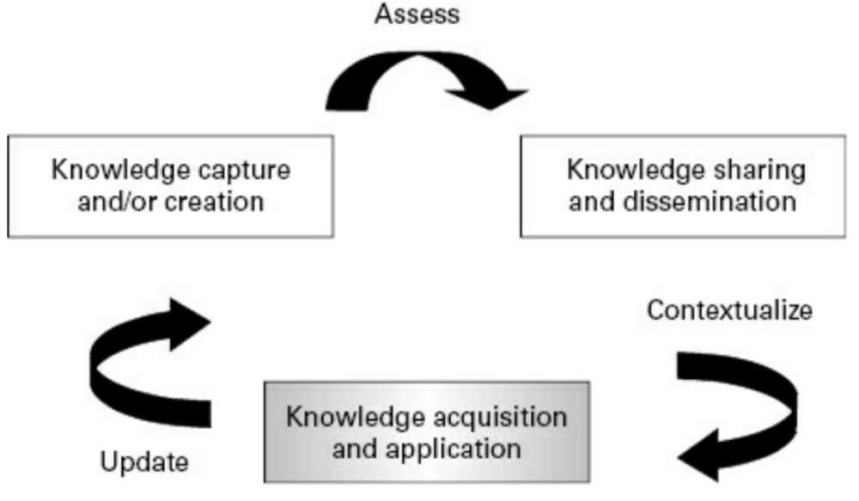

Introduction

Slide 5
Introduction
Knowledge management typically addresses one of two general objectives:
Knowledge reuse to promote efficiency and innovation to introduce more effective ways of doing things.
Knowledge application refers to the actual use of knowledge that has been captured or created and put into the KM cycle

Slide 6
Introduction
The knowledge spiral needs to be completed by successful internalization of knowledge
These knowledge objects can be explained references. Components (program or text), templates, patterns, or other types of containers
The goal is to reduce the time it takes to complete tasks

Slide 7
Introduction
If knowledge workers can easily locate and communicate with individuals in the company that are connected to a given knowledge object (e.g., they are familiar with how it is used, the have been trained, etc.), then the ability to apply or to make use of this knowledge is greatly increased

Slide 8
Introduction
A common assumption in the past was that all relevant knowledge could be bundled up in nice, neat, easily accessible packages of “best practices” that practitioners could then “repeat”.
Dixon (2000) outlines factors that affect knowledge transfer:
Characteristics of the receiver (skill, shared language, technical knowledge),
The nature of the task (routine, non routine)
The type of knowledge being transferred (a continuum from explicit to tacit).

Slide 9
Knowledge Application at the Individual Level
Characteristics of the individual knowledge workers
Bloom’s Taxonomy of Learning Objectives
Task Analysis and Modeling
Electronic Performance Support Systems

Slide 10
Characteristics of the individual knowledge workers
  Individual differences play a major role in knowledge-sharing behaviors (Hicks and Tochtermann).
  Knowledge workers vary with respect to their familiarity with the subject matter and their personality and cognitive styles. Cohen and Levinthal (1990) found that sharing is more likely to occur when a foundation of prior relevant knowledge exists
  Characteristics of the individual who is seeking to apply or reuse knowledge are likely to play a role in how effective he or she is at finding, understanding, and making use of organizational knowledge

Slide 11
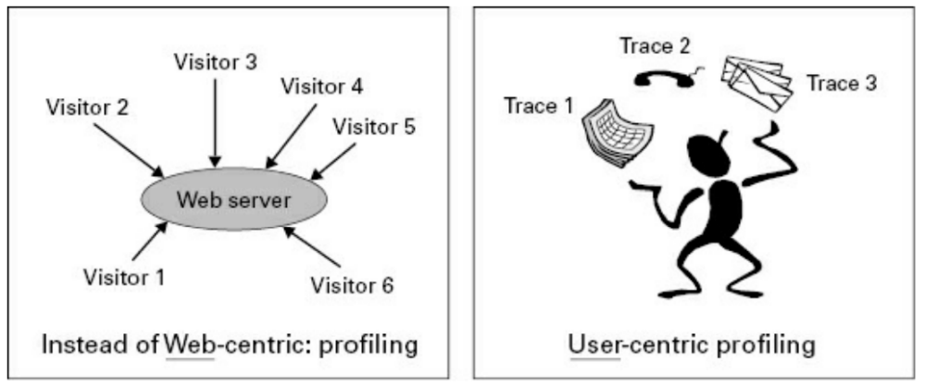
Characteristics of the individual knowledge workers

Slide 12
Characteristics of the individual knowledge workers
There are also systems that monitor users’ tasks online and interpret them in context, based on traces they leave behind. These systems work well for tasks that are well identified and where knowledge can be described in a clear ontology
In general, this approach is based on a user interacting with a computer system to perform a task that leads to changes in the system

Slide 13
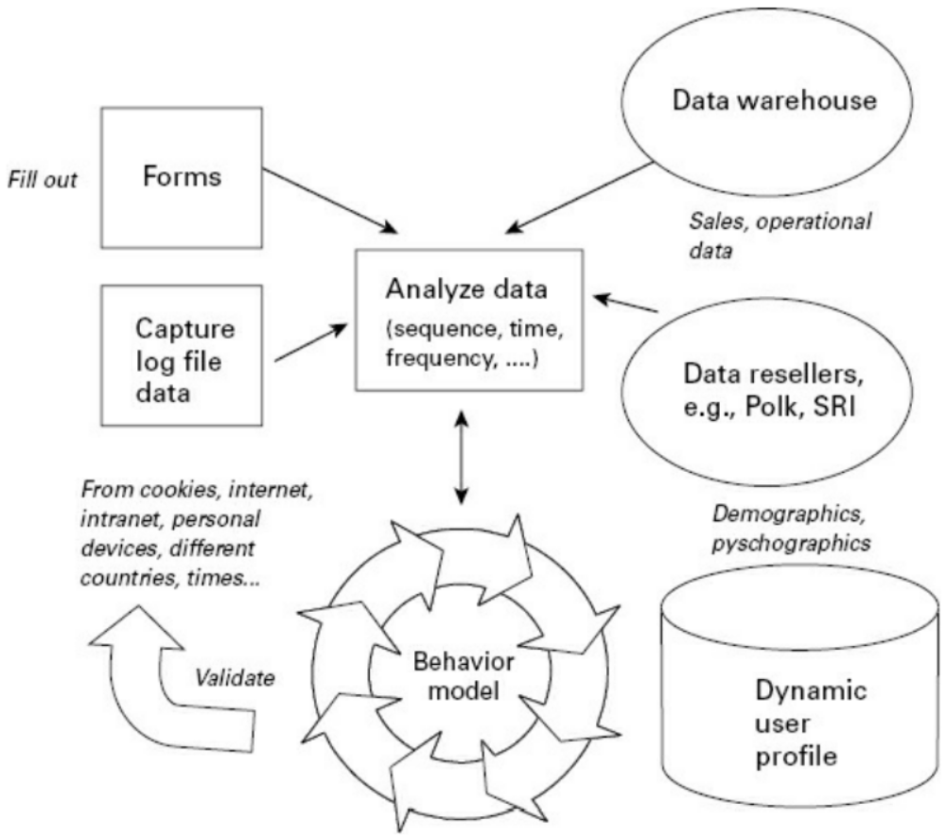
Characteristics of the individual knowledge workers
In this way, the system has modeled how users behave when they are undertaking these particular types of tasks

Slide 14
Knowledge Application at the Individual Level
Characteristics of the individual knowledge workers
Bloom’s Taxonomy of Learning Objectives
Task Analysis and Modeling
Electronic Performance Support Systems

Slide 15
Bloom’s Taxonomy of Learning Objectives
Bloom’s Taxonomy of Learning Objectives Bloom (1956) divided knowledge into a hierarchical scheme that distinguishes between psychomotor skills:
  the affective domain (e.g., attitudes)
  the cognitive domain (e.g., knowledge).
The cognitive domain is more commonly used, although attitudinal changes are often required in knowledge management too.

Slide 16
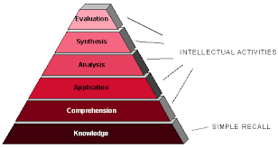
Bloom’s Taxonomy of Learning Objectives
Cognitive: the most-used of the domains. Cognitive domain
Refers to knowledge structures
(although sheer “knowing the
facts” is its bottom level
The model is included because
it is still common currency

Slide 17
Bloom’s Taxonomy of Learning Objectives
The Bloom taxonomy serves as a means of determining not only
What knowledge workers are expected to do (usually referred to as skills or expertise) but also the level of performance that is expected (also referred to as mastery level)
Knowledge fails to be used not because it has not been understood but because the knowledge worker is not convinced that this new best practice or lesson learned represents any significant improvement over the way he or she is already working

Slide 18
Bloom’s Taxonomy of Learning Objectives
A user model is not enough, however, for the facilitation of knowledge application. We also need to know what the users are doing and what their goals or purposes are in applying this knowledge object
Moreover, we will also require a task model. As with the user model, the task model will serve to be better characterize why someone would apply a particular knowledge item.
A user and task-adapted approach is highly recommended in order to facilitate internalization processes

Slide 19
Knowledge Application at the Individual Level
Characteristics of the individual knowledge workers
Bloom’s Taxonomy of Learning Objectives
Task Analysis and Modeling
Electronic Performance Support Systems

Slide 20
Task Analysis and Modeling
Task analysis studies what knowledge workers must do with respect to specific actions to be taken and/or cognitive processes that must be called upon to achieve a particular task (e.g., Preece et al., 1994).
The most commonly used method is task decomposition, which breaks down higher-level tasks into their subtasks and operations.
The lower levels may make use of task flow diagrams, decision flowcharts, or even screen layouts to better illustrate the step-by-step process that has to be undertaken in order to complete a task successfully.

Slide 21
Task Analysis and Modeling
The task decomposition can be carried out using the following stages:
  1. Identify the task to be analyzed.
  2. Break this down into four to eight subtasks. These subtasks should be specified in terms of objectives and, between them, should cover the whole area of interest.
  3. Draw the subtasks as a layered diagram ensuring that it is complete.

Slide 22
Task Analysis and Modeling
  4. Decide upon the level of detail into which to decompose. Making a conscious decision at this stage will ensure that all the subtask decompositions are treated consistently. It may be decided that the decomposition should continue until flows are more easily represented as a task flow diagram.

Slide 23
Task Analysis and Modeling
  5. Continue the decomposition process, ensuring that the decompositions and numbering are consistent. It is usually helpful to produce a written account as well as the decomposition diagram.
  6. Present the analysis to someone else who has not been involved in the decomposition but who knows the tasks well enough to check for consistency.
  Task flow analysis can include details of interactions between the user and the current system, or other individuals, and any problems related to them

Slide 24
Knowledge Application at the Individual Level
Characteristics of the individual knowledge workers
Bloom’s Taxonomy of Learning Objectives
Task Analysis and Modeling
Electronic Performance Support Systems

Slide 25
Electronic Performance Support Systems
EPSS
Electronic Performance Support Systems, Gery (1991) defined EPSS as an integrated electronic environment that is available to and easily accessible by each employee and is structured to provide immediate, individualized online access to the full range of information, software, guidance, advice and assistance, data, images, tools, and assessment and monitoring systems to permit job performance with minimal support and intervention by others.

Slide 26
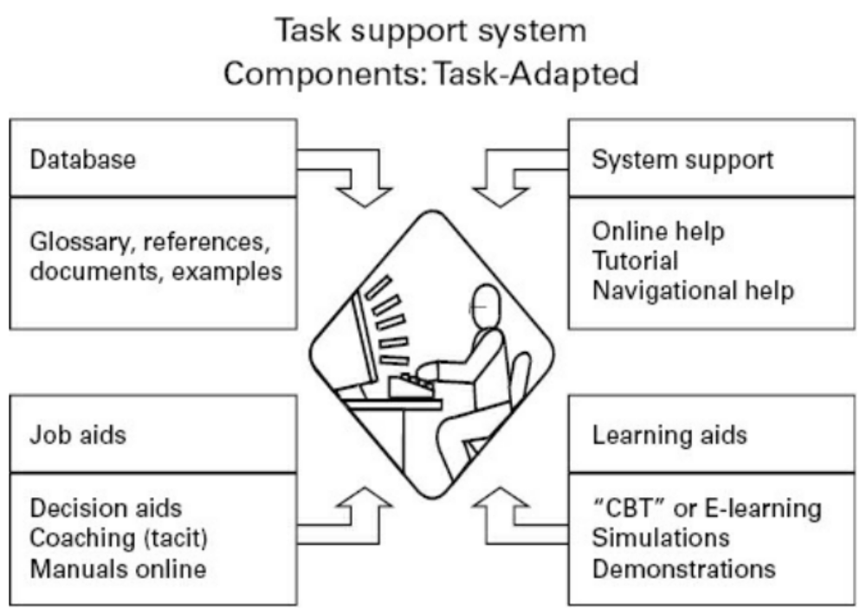

Electronic Performance Support Systems

Slide 27
Knowledge Application at the Group and Organizational Levels
Knowledge management systems (KMSs) are tools aimed at supporting knowledge management. They evolved from information management tools that integrated many aspects of computer-supported collaborative work (CSCW) environments with information and document management systems (Ganesan, Edmonds, and Spector, 2001; Greif, 1988; Kling, 1991).

Slide 28
Knowledge Application at the Group and Organizational Levels
Key characteristics of a KMS are support for:
    1. Communication among various users.
    2. Coordination of users’ activities.
    3. Collaboration among user groups on the creation, modification, and dissemination of artifacts and products.
    4. Control processes to ensure integrity and to track the progress of projects.

Slide 29
Knowledge Application at the Group and Organizational Levels
A KMS provides support for many information functions, including:
      1. Acquiring and indexing, capturing, and archiving.
      2. Finding and accessing.
      3. Creating and annotating.
      4. Combining, collating, and modifying.
      5. Tracking.

Slide 30
Knowledge Application at the Group and Organizational Levels
The organizational knowledge management architecture will be comprised of at least three levels:
  Data layer, which is the unifying abstraction across different types of data, with potentially different types of data, with potentially different storage mechanism (e.g., database, text documents, video, audio).
  Process layer, which describes the logic that links the data with its use and its users (other people or other systems who use that data).
  User interface, which provides access to the information assets of the company via the logic incorporated in the process layer.

Slide 31
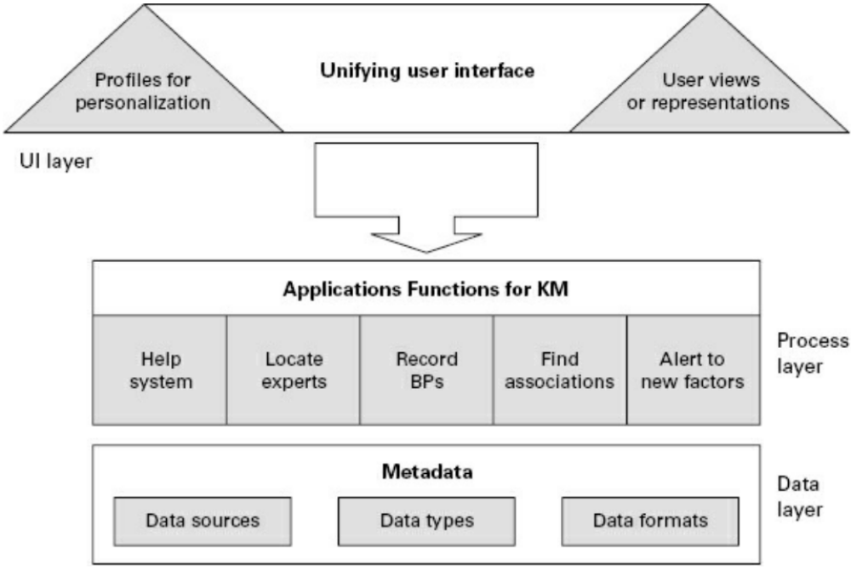

Knowledge Application at the Group and Organizational Levels

Slide 32
Knowledge Application at the Group and Organizational Levels
Knowledge Reuse
Reusing knowledge involves recall and recognition, as well as actually applying the knowledge, if we use Bloom’s taxonomy.
Reusing knowledge typically begins with the formulation of a search question.

Slide 33
Knowledge Application at the Group and Organizational Levels
Knowledge Reuse
There are three major roles required for knowledge reuse:
  The knowledge producer, the person who produced or documented the knowledge object;
  The knowledge intermediary, who prepares knowledge for reuse by indexing, sanitizing, packaging, and even marketing the knowledge object;
  The knowledge reuser, who retrieves, understands, and applies it.

Slide 34
Knowledge Application at the Group and Organizational Levels
Knowledge Reuse
Markus (2001) suggests there are four distinct types of knowledge reuse situation according to the individual who is doing the reusing and the purpose of knowledge reuse.

Slide 35
Knowledge Application at the Group and Organizational Levels
Knowledge Reuse: The four reuse situations are:
  Shared work producers usually consist of teams or workgroups that have collaborated together
  Shared work practitioners are members of the same community of practice. They are peers who share a profession.
  Expertise-seeking novices are often in a learning scenario. Unlike the previous two types of reusers, novices are the most distant or different from the knowledge object authors and those experienced with its use
  Secondary knowledge miners are analysts who attempt to extract interesting and hopefully meaningful patterns by studying knowledge repository use.

Slide 36
Knowledge Application at the Group and Organizational Levels
Knowledge Repositories
Knowledge repositories are usually intranets or portals of some kind that serve to preserve, manage, and leverage organizational memory.
Many different types of knowledge repositories are in use today, and they can be categorized in a number of different ways. In general, a knowledge repository will contain more than documents (document management system), data (database), or records (record management system).

Slide 37
Knowledge Application at the Group and Organizational Levels
Knowledge Repositories
A knowledge repository will contain valuable content that is a mix of tacit and explicit knowledge, based on the unique experiences of the individuals who are or were a part of that company as well as the know-how that has been tried, tested, and found to work in work situations.

Slide 38
Real World Applications of KM
There is a wide range of KM applications in the real world. They can be found in every sector, including the for-profit and nonprofit sectors; NGOs and developmental agencies; government at the federal, state/province (states in the United States and provinces in Canada), and municipal levels; and for all the vertical industry sectors, ranging from agriculture to the water industry.

Slide 39
Real World Applications of KM
Aerospace: NASA: KM is used to ensure that NASA is a learning organization. Applications include a comprehensive lessons learned database, case studies, and stories.
Agriculture: Embrapa, the Brazilian Agricultural Research Corporation’s KM system manages both the knowledge produced and knowledge development process and incorporates learning that takes place during the research process.

Slide 40
Real World Applications of KM
Chemical: Buckman Laboratories, a KM leader, sells chemical products, services, and solutions and emphasizes knowledge sharing: “… so that no individual will stand alone in the face of competition, but will always have the full global force of the company behind them.” —Bob Buckman. The K’Netix knowledge portal allows employees to share knowledge and also stores and preserves all organizational knowledge and experience.
Computer: IBM was one of the early adopters of KM and continues to focus on collaboration applications such as a searchable resource to look for experts company-wide.

Slide 41
Real World Applications of KM
Construction: Fluor Corporation is an engineering, procurement, construction, and maintenance firm that has institutionalized KM by developing KnowledgeOnline, which connects people to people and people to content to create global knowledge communities.
Education: Triune developed Air Force Knowledge Now, a mechanism for finding and accessing time critical knowledge, training, and performance support resources to provide online performance support to the workforce. It encompasses support for communities of practice, elearning, learning management systems, and comprehensive metrics.

Slide 42
Strategic Implications of Knowledge Application
Knowledge application implies that employees in an organization can quickly find answers to the following types of questions:
  What have we already written or published on this topic?
  Who are the experts in this area and how can I contact them?
  Have any of our partners, contacts, and clients addressed these issues?
  What sources did we use to prepare the publications on this topic?
  What are the best websites or internal databases to go to find more information?
  How can I add my own experience applying this particular piece of knowledge?

Slide 43
Strategic Implications of Knowledge Application
A knowledge repository should be a one-stop shop for knowledge application. Employees should be able to find out what they need in order to access, understand, and apply the cumulative experience and expertise of the organization.

Slide 44
Summary
Understand how user and task modeling approaches can help promote effective knowledge use at the individual, group, and organizational level
Describe how an organizational knowledge management architecture is designed
Define organizational learning and describe the links between individual and organizational learning
Compare and contrast learning and understanding with internalization of knowledge
List the different knowledge support technologies that can help users put knowledge into action

Slide 45
Discussion / Homework / Team Activities
What are some of the tools used in organizational memory management?
What are the key components that should be addressed by an organizational KM architecture?
What is reuse and why is it an important measure of the success of KM within an organization?
Why is knowledge application the most important step in the KM cycle?
How does knowledge application relate to the internalization phase of the Nonaka and Takeuchi knowledge spiral model?
Why counting the number of “hits” to a knowledge repository (much like website statistics) would not be the best measure of knowledge application within an organization.
What is chunking? Why is this a good content management strategy?
Provide an example of a task analysis for a task you are familiar with.

